Slide 1


Steven King
Creating Immersive
Storytelling Experience
Professor of Emerging Technologies
Leveraging VR, AR and Ai to engage audiences
Notes:
50 years ago, My Grandmother was told, you will be able to cook dinner in 3 minutes. No more slaving in the kitchen cooking, just put the food in the box, press the button and out comes a delicious, hot meal.

Slide 2
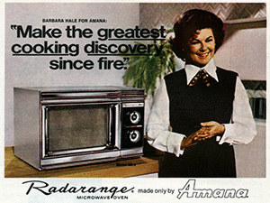
Notes:
The greatest discovery since Fire.
Did that prediction come true?

Slide 3
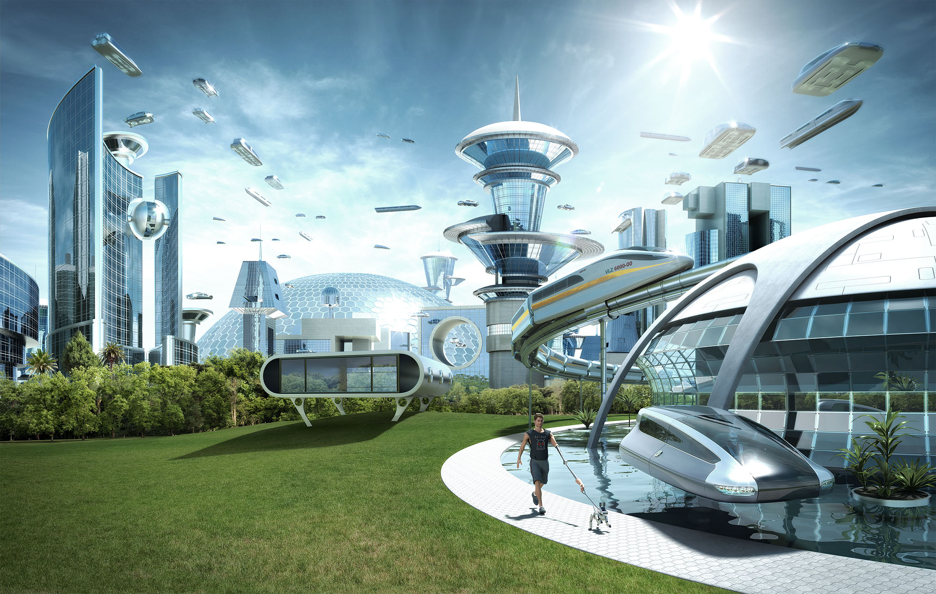
Notes:
People have dreamed of electric cars, self-driving cars and even flying cars. We dream of diets with no calories, wars with no death and life without pain.

Slide 4
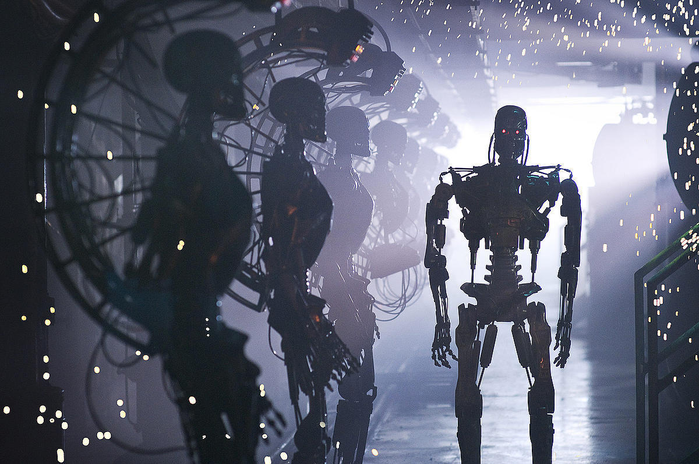
Notes:
They say robots will take our jobs, Ai with become self-aware and take over the world and the machine will become our master.

Slide 5
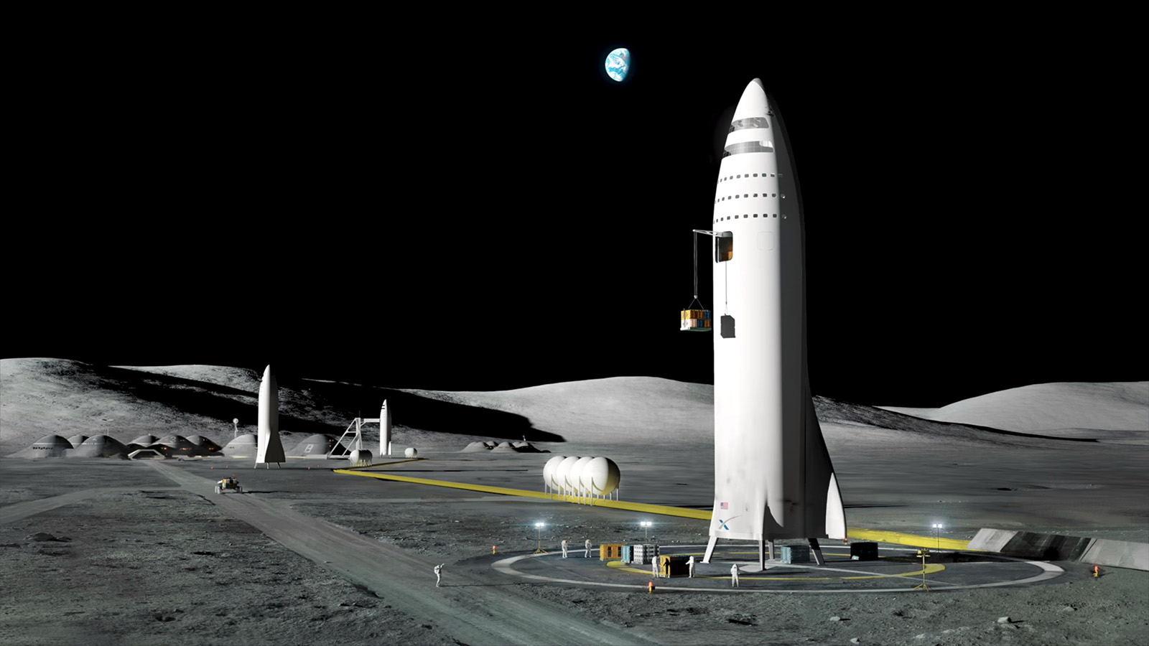
Notes:
Elon Musk The Great is going to take us to space as Tourists in a Tesla Rocket Train, we will colonize Mars and take journeys across the galaxy using renewable energy.

Slide 6
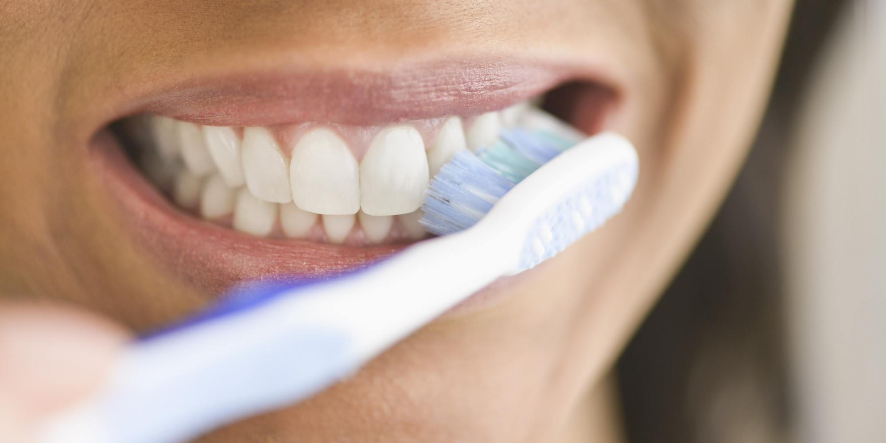
Notes:
But why do we still have to brush our teeth? I mean Chemists have crated scotch guard for furniture, bullet-proof fabric and glue that will seal the cockpit at 500 miles per hours at 30,000 feet but we can’t make something so I don’t have to tell my boys to brush their teeth every night.
Just asking…

Slide 7
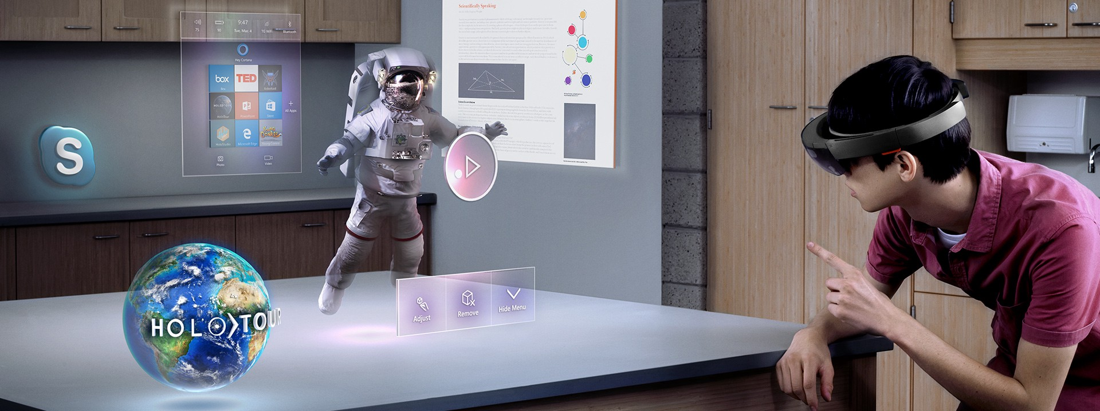
Notes:
We have all these new realities, Virtual Reality, Augmented Reality and Mixed Reality. We have self-driving cars and artificially intelligent dots that sit on our table.

Slide 8
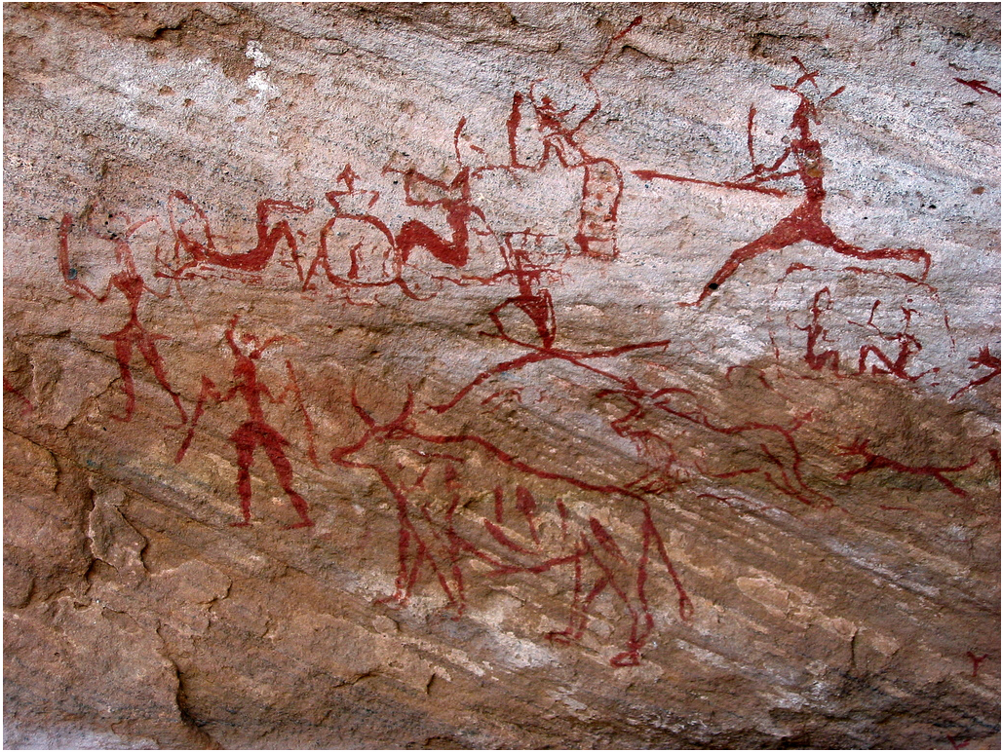
Notes:
But humans have been experiencing alternate realties for centuries through Story. Even before men scratched stories on caves they told and heard stories as they worked in the garden. Narrative story has been told and shared since human creation and we tell each other stories every day, always advancing the medium.

Slide 9
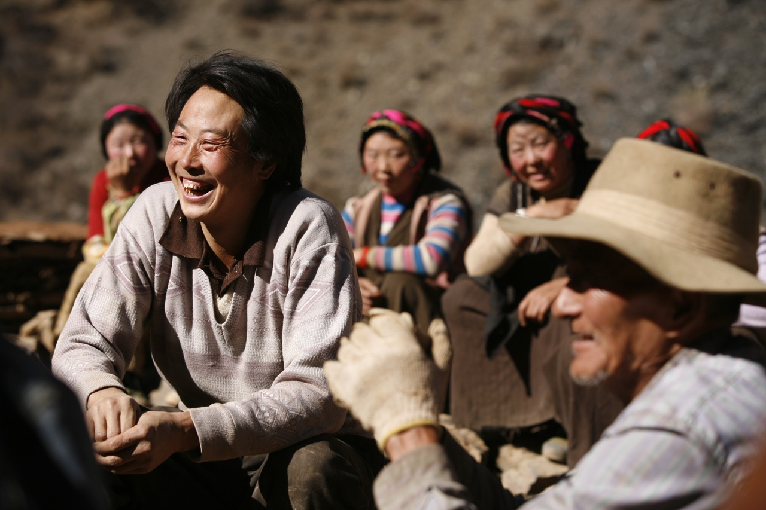
Notes:
On top of a Tibetan home, sitting the shadow of the himilays , I heard a 25 year old Tibetan father tell his family story after story. Stories that made them laugh, and stories that made them look at their feet in silence and ponder.

Slide 10
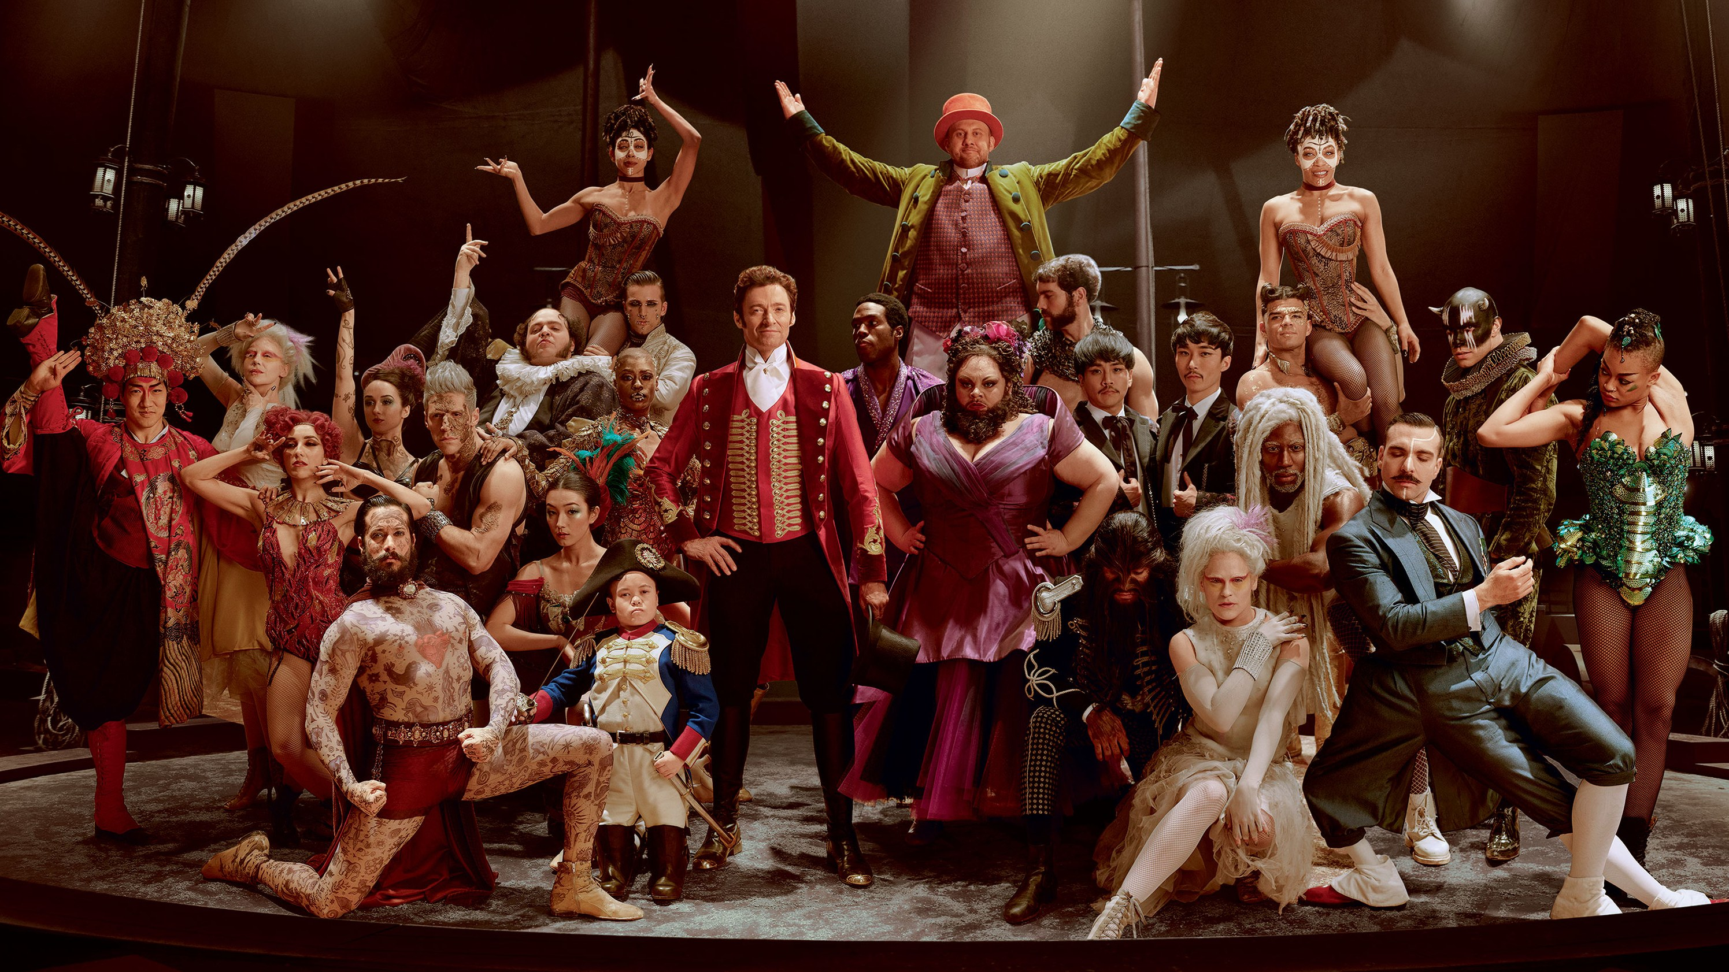
Notes:
And in chapel hill last week I paid $15 to sit in a leather chair and smile, laugh and feel stress as Hugh Jackman sang a story to me in a musical that was unique in presentation and narrative.

Slide 11
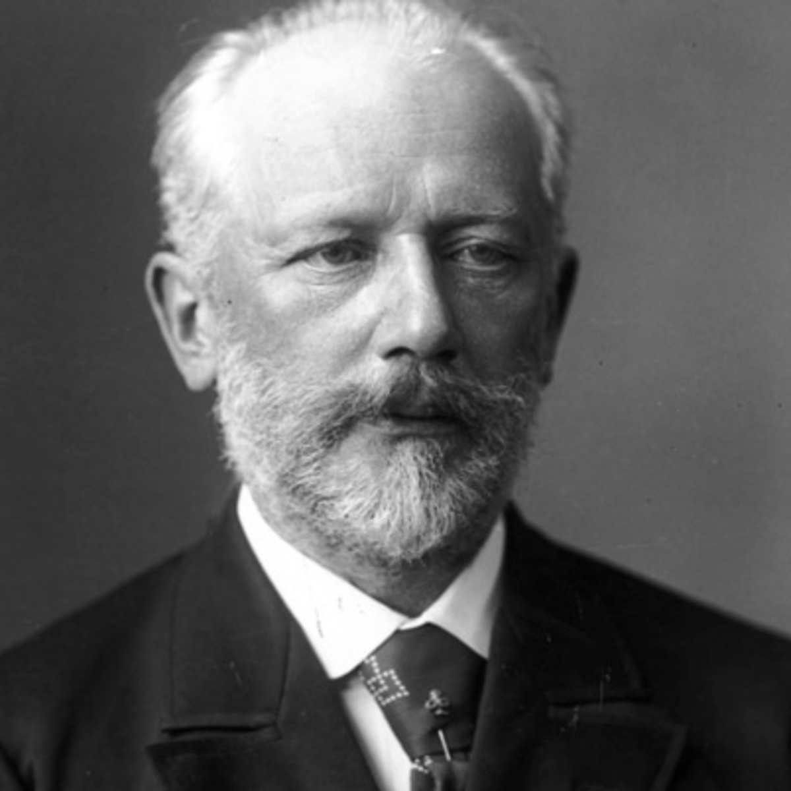
Notes:
Tchaikovsky was an unknown composer when he went to see the ballet. The dancing was amazing but he felt the music was weak. And he had an idea. What if he combined the crafts. Combined the two crafts and used the visual medium of ballet, combined with the emotion of strong narrative musical score to tell a story.
Think about that for a moment. In the mid 1800’s we had audio and visual for thousands of people in a theater in Moscow.
Do you know the title of the first ballet Tchaikovsky wrote?

Slide 12
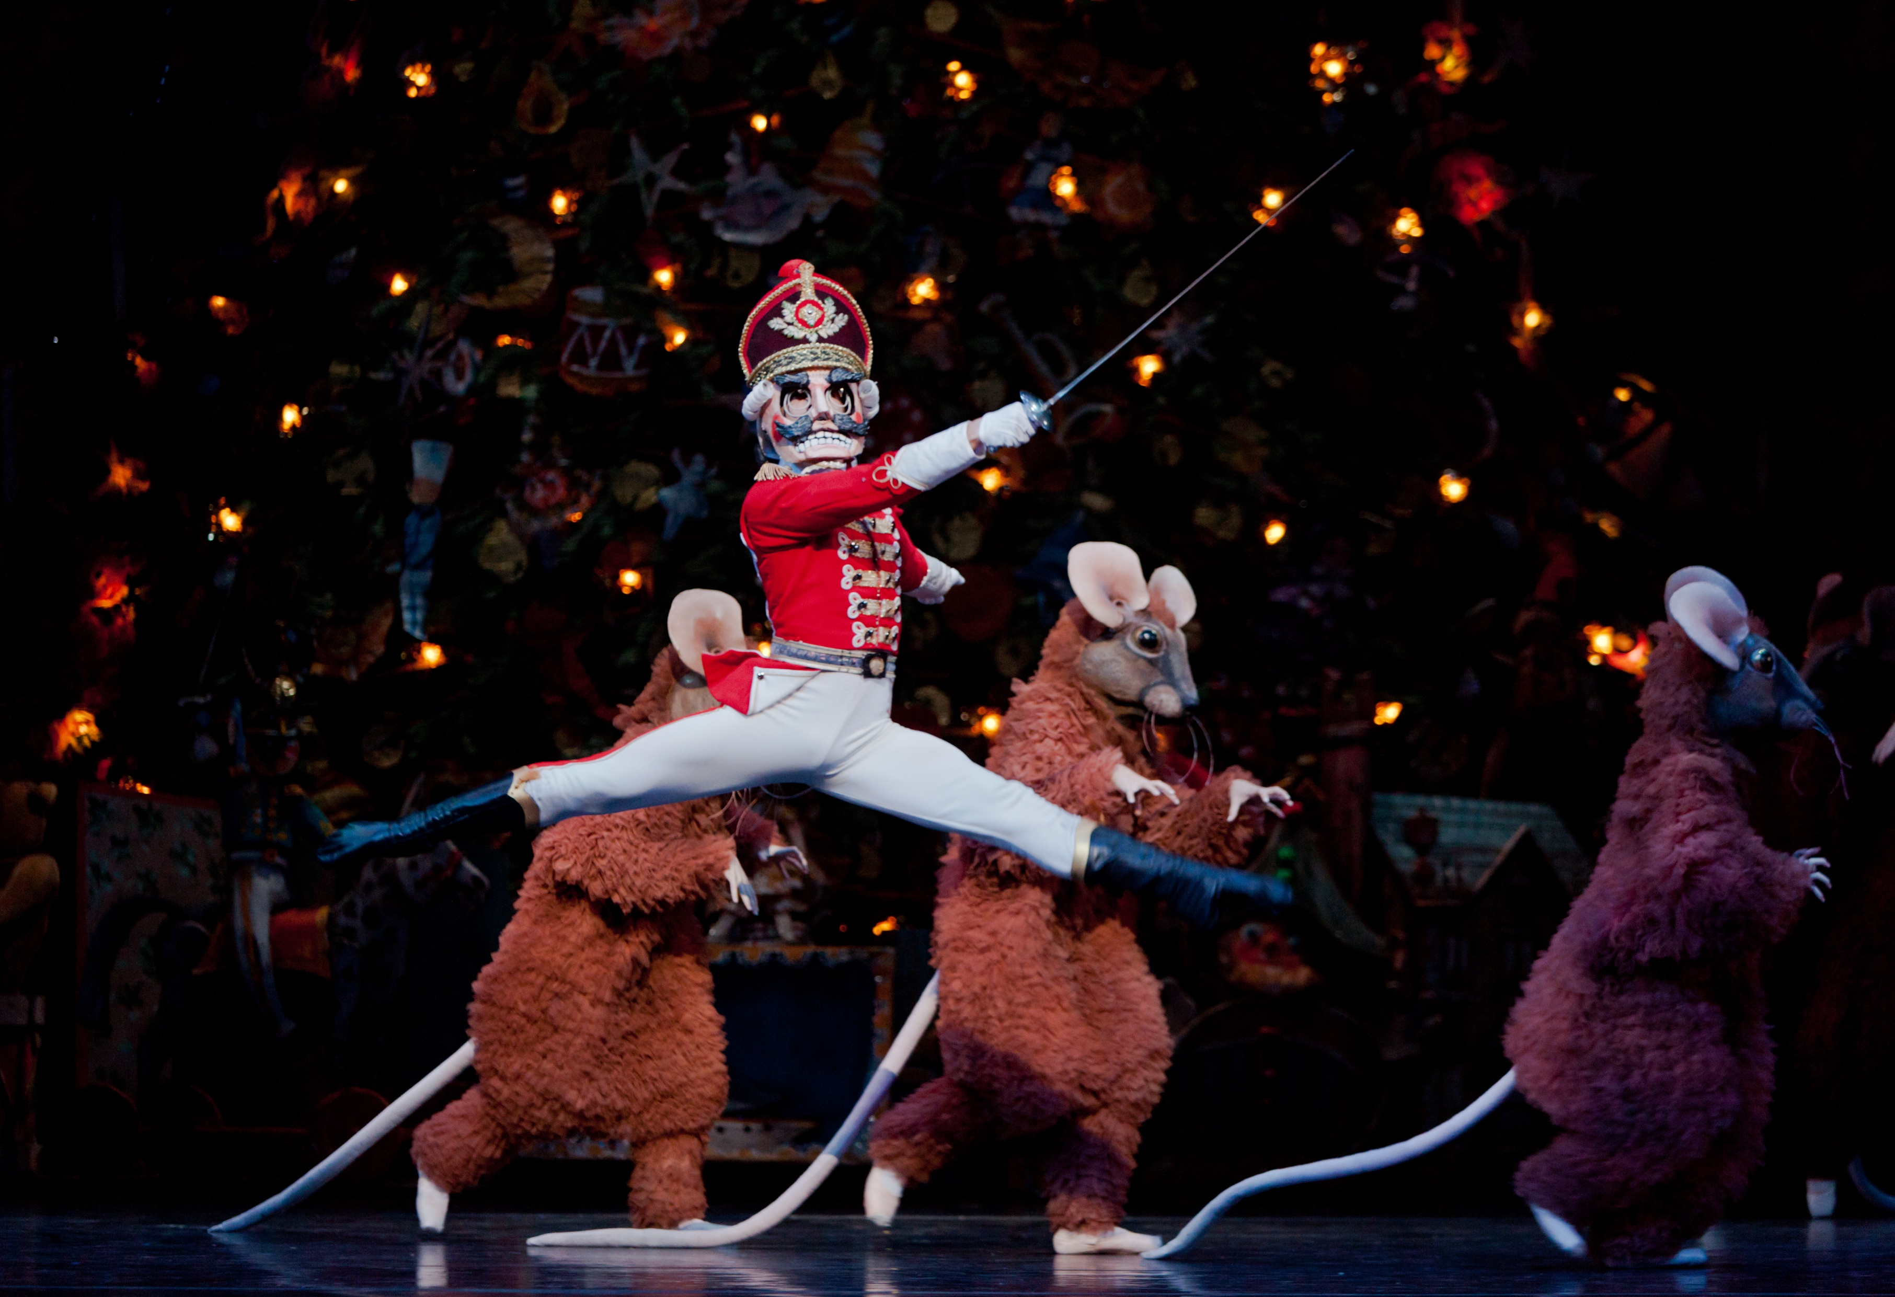
Notes:
Swan Lake. Do you know his second, The Nutcracker.
He was a storyteller. But he was a media innovator.

Slide 13
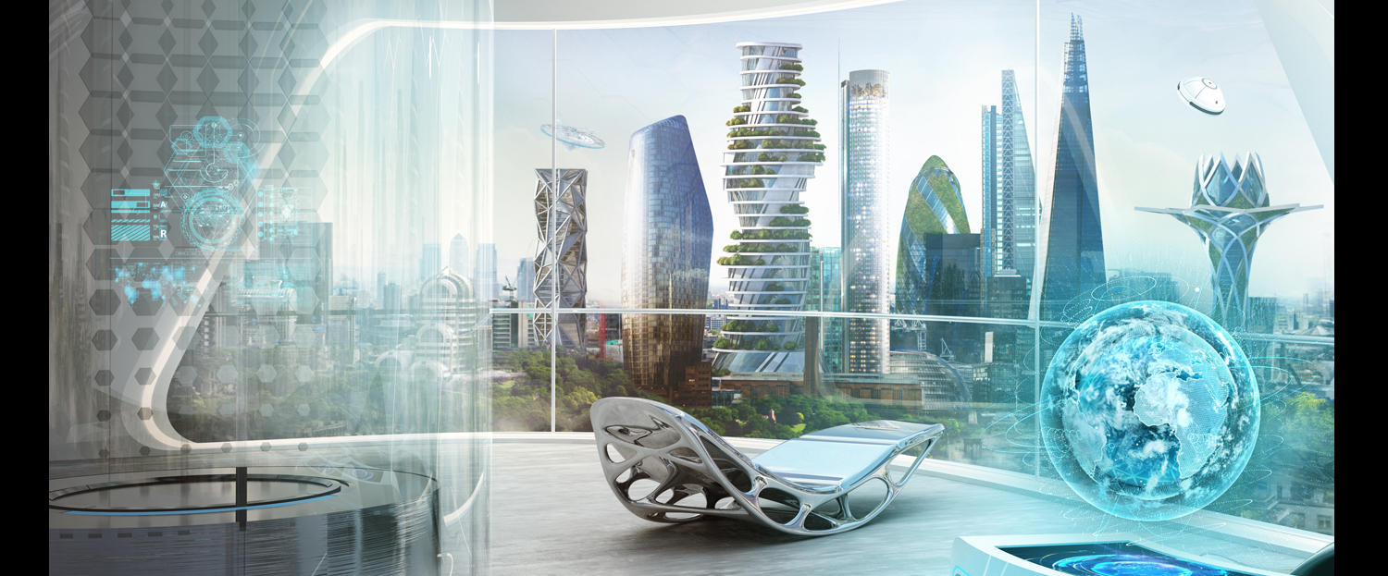
Notes:
That is what we will do in this class. We are going to see and understand the technologies that are coming and learn how to leverage them to tell stories in ways no one has before. I am going to teach you how to read the signals to predict technological trends and ignore the fads. To understand how human nature, culture and politics effect technology. I am going to teach you have to ideate and then implement those ideas. I am going to teach you how to figure stuff out. And most importantly, I am going to teach you to be fearless and to try things you have no idea how to accomplish.
So, if you want to be Tchaikovsky of virtual reality or become the Steven Spielberg of the self-driving car then we in for an exciting semester.

Slide 14
Notes:
And in chapel hill last week I paid $15 to sit in a leather chair and smile, laugh and feel stress as Hugh Jackman sang a story to me in a musical that was unique in presentation and narrative.

Slide 15
Notes:
And in chapel hill last week I paid $15 to sit in a leather chair and smile, laugh and feel stress as Hugh Jackman sang a story to me in a musical that was unique in presentation and narrative.

Slide 16
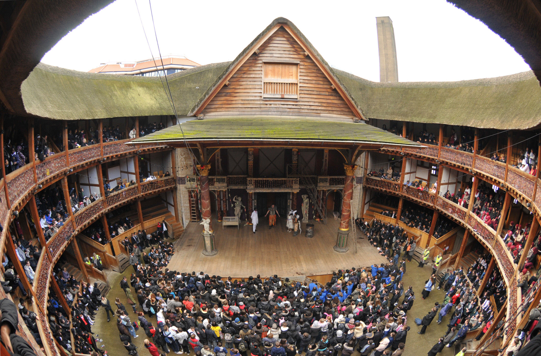
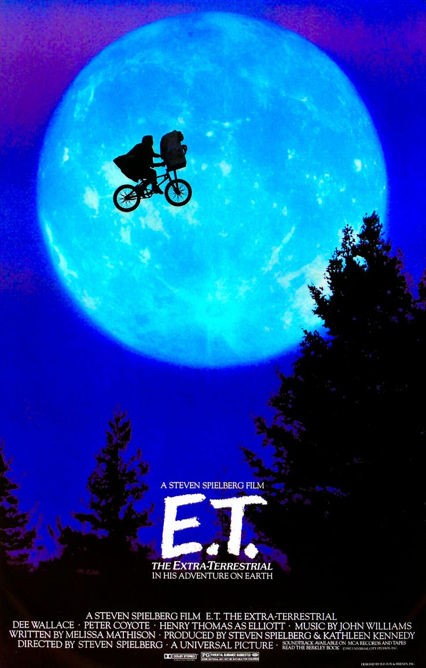
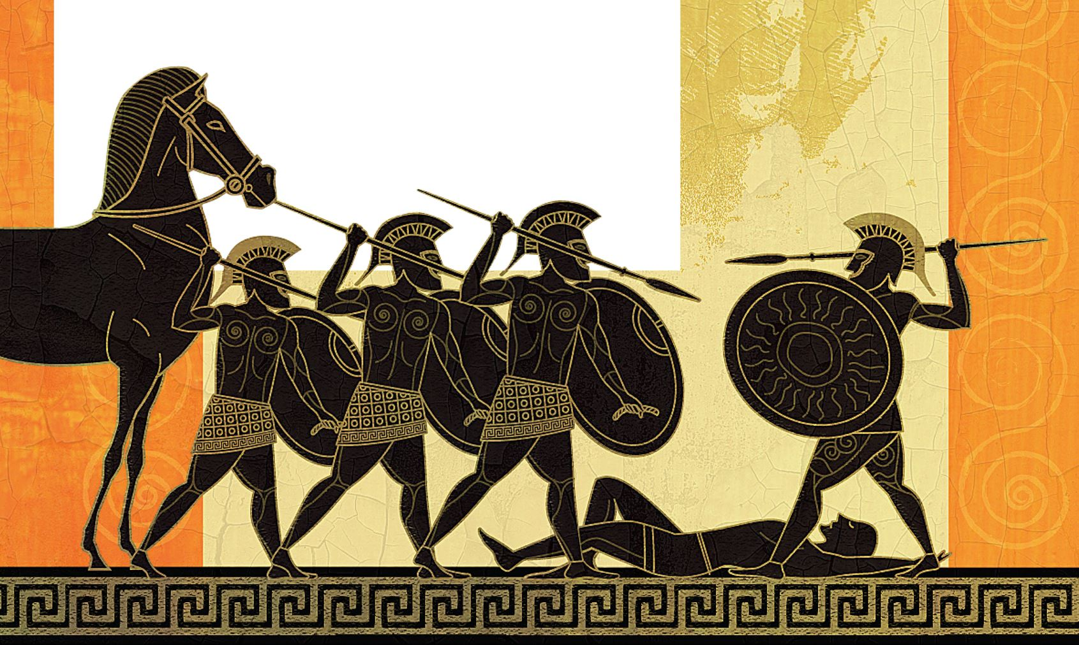
Notes:
Homer in ancient script, Shakespeare in the Theater and Spielberg on the big screen. Each has evolved the craft to drive the emerging medium. A medium they helped create. Storytelling methods they invented, mastered and shared.

Slide 17
Storytelling with
Emerging Technology
We use emerging technologies with strong stories to solve existing problems

Slide 18
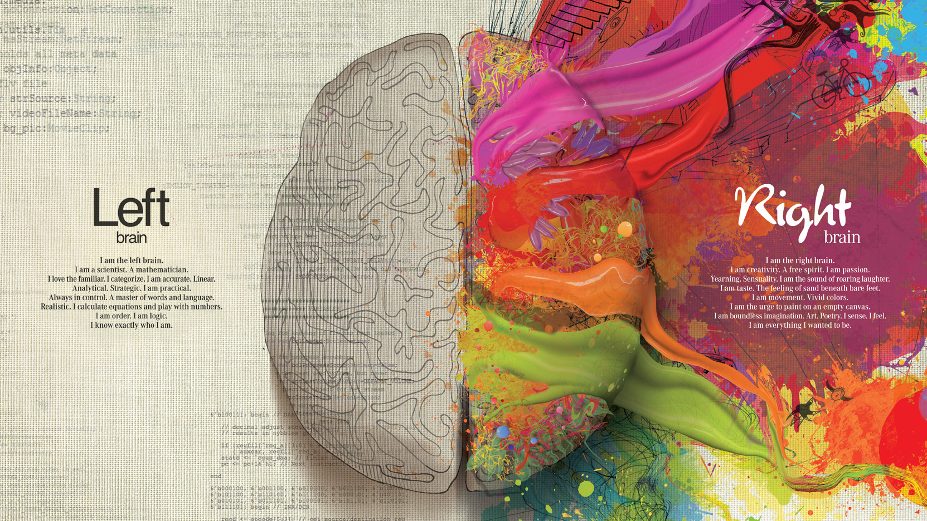

Slide 19
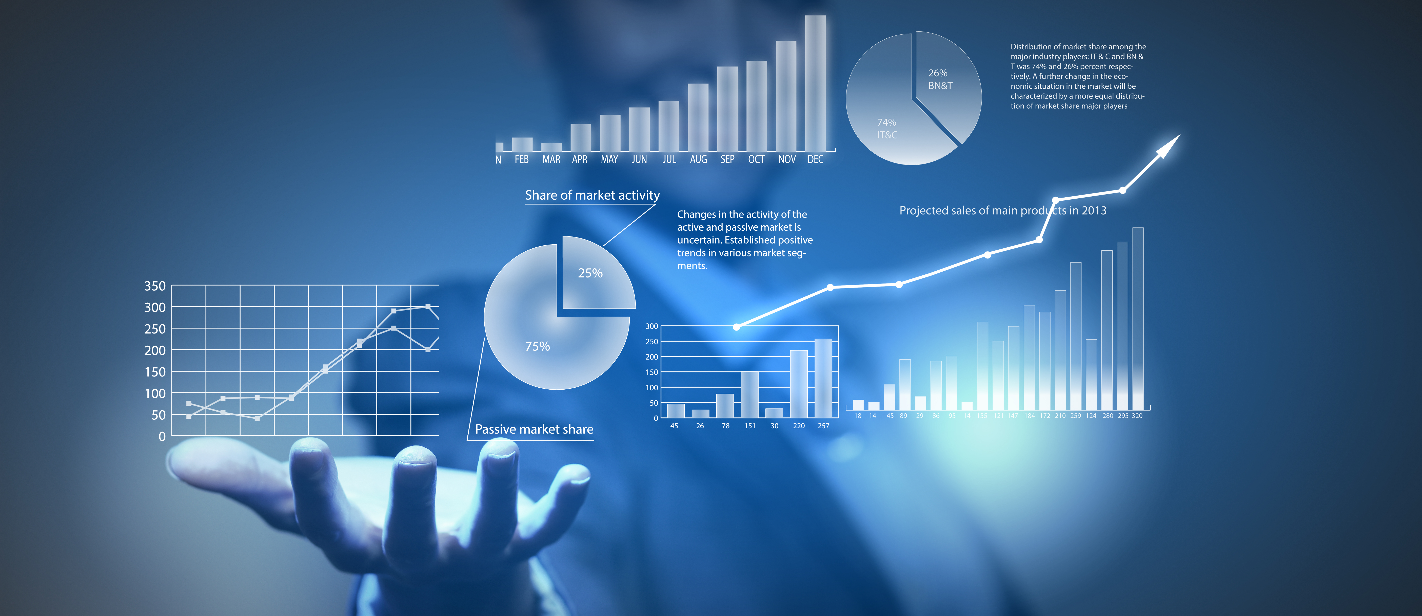
Real Trends

Slide 20
Real Trends

Slide 21
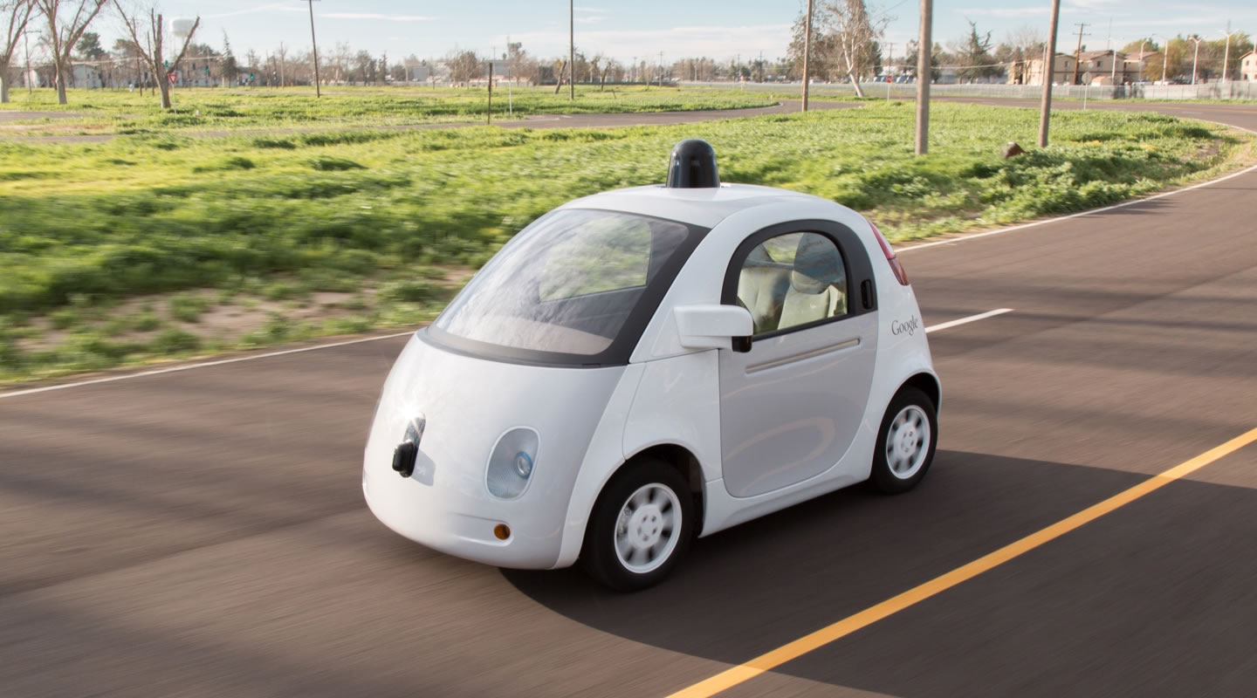

Slide 22
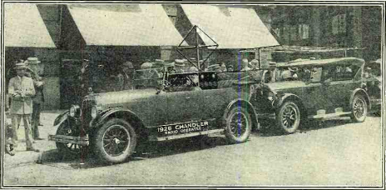
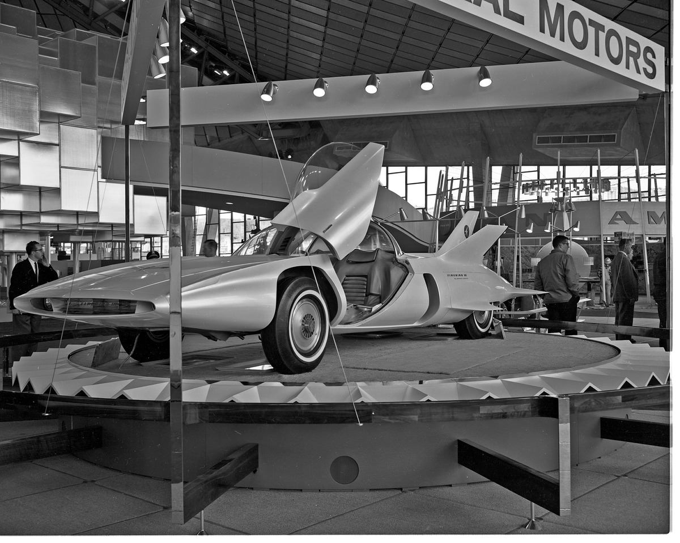
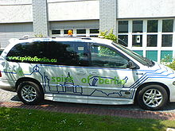
First Driverless Car
1925 Houdina Radio Control
1950’s GM and RCA Car
1962’s Firebird
2001 DARPA Challenge

Slide 23
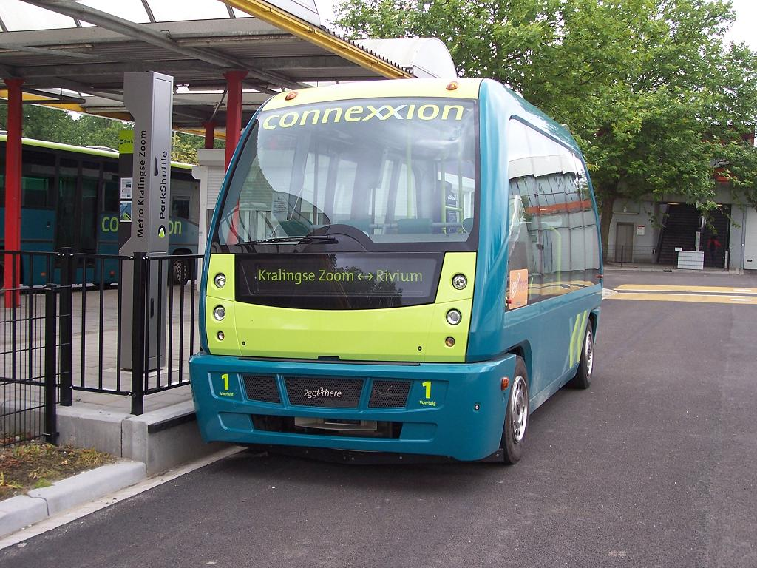
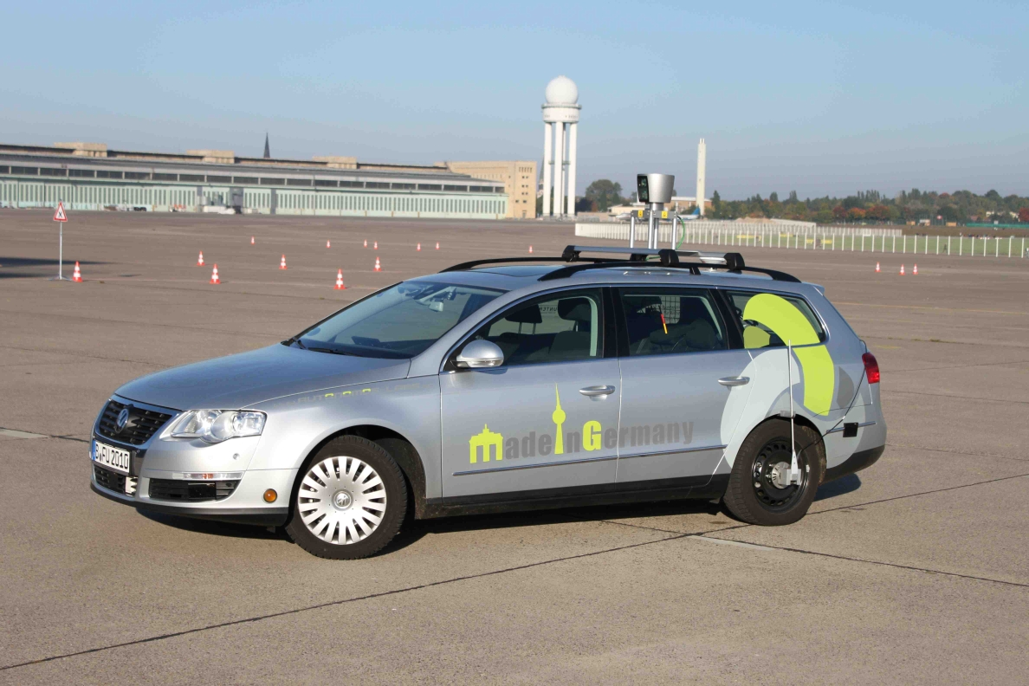
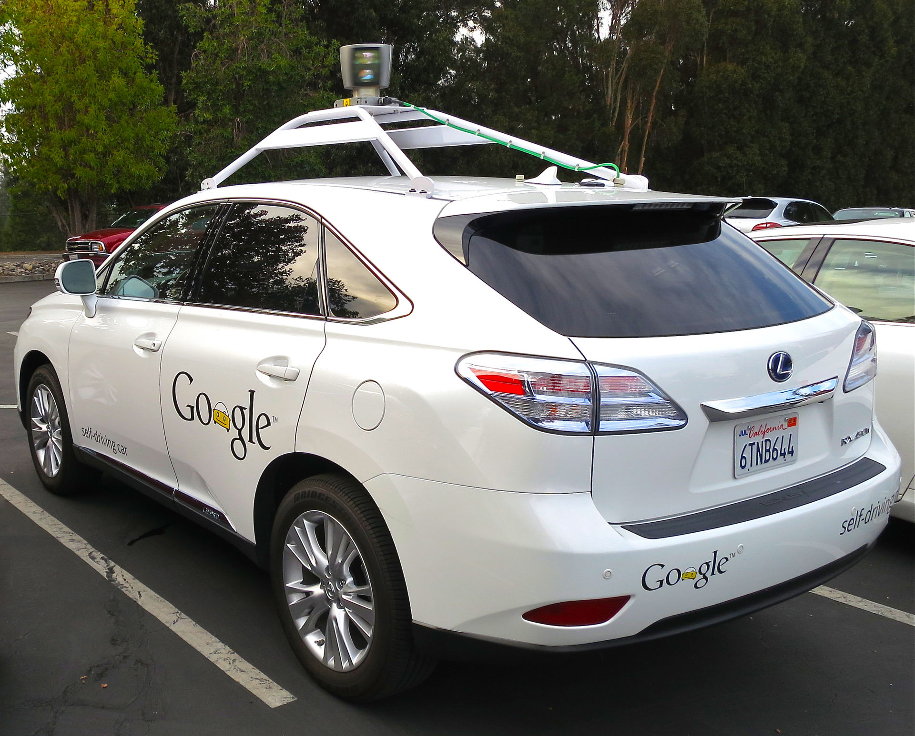
Driverless Cars
2007 Spirit of Berlin
2008 Pride of Germany
2008 Auto Park Shuttle
2010’s
GM
Ford
Apple
Honda
Toyota

Slide 24
Real Trend: Self Driving Car
GPS
Navigation
Points of Interest
Less Fuel Use
More Analytics
Object Detection
Detect Cars
Detect Humans
Auto Pilot
Cruise Control
Enabled Easier Driving
Enabled Multitasking
4G
Battery Cars
Data for cars
Data for people
On demand
Uber

Slide 25
Future of the Car
2016
Park assist
2025-2035
2040 and beyond
No one owns a car. You commute time.
Autopilot
Object avoidance
2020-2025
Adv. Mobile data
Swarm Tech
Highway system upgraded
Multitasking commute
Adapted from Future Today Institute 2016 Report

Slide 26




Slide 27

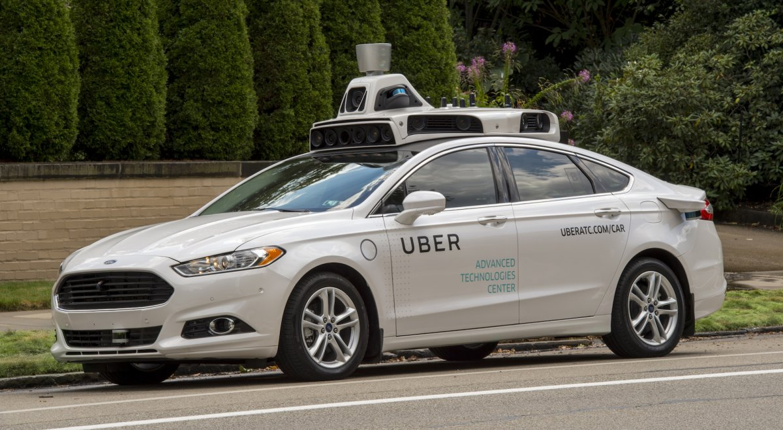
Notes:
Innovative Company
Rich on capital
Innovating now
Consumer engaged

Slide 28
How to Predict Real Trends?
Watch the Fringe research and publications.
Are there multiple players in the game?
Does it fulfill a current need?
Are the advancements growing and is the time between shortening?
Are others not involved writing about it?
Do you think it is interesting?

Slide 29
How to apply trends
Take a How approach
Brainstorm with others in the field about specific applications to your field.
What are the concerns?
Privacy
Security
Financial
Perception
Build a prototype and show it around

Slide 30
Trend: Bots

Slide 31
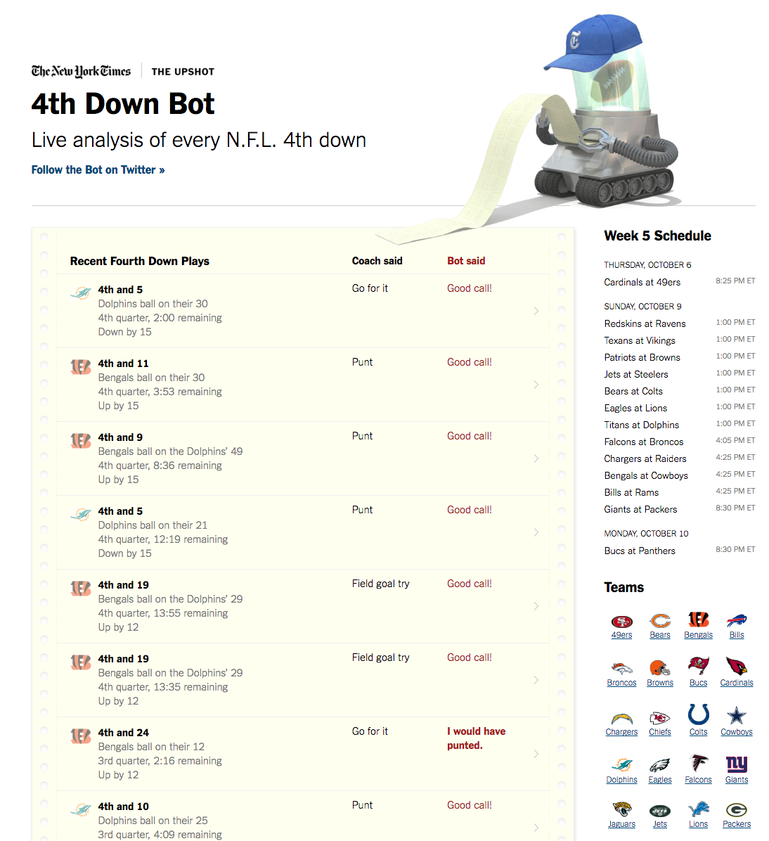
Bots
Software preforming automated tasks that interface with humans.

Slide 32
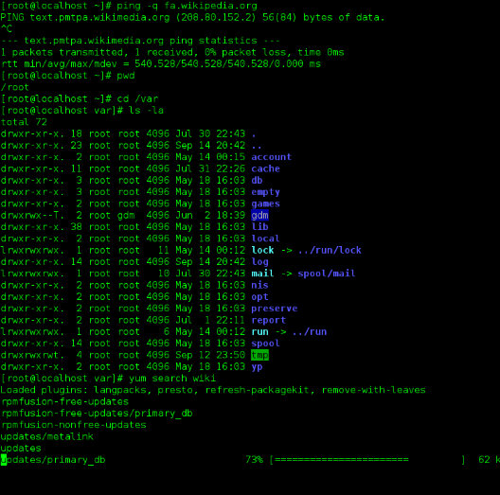
Bots
Software preforming automated tasks that interface with humans.

Slide 33
Trend: [Conversational] Bots

Slide 34
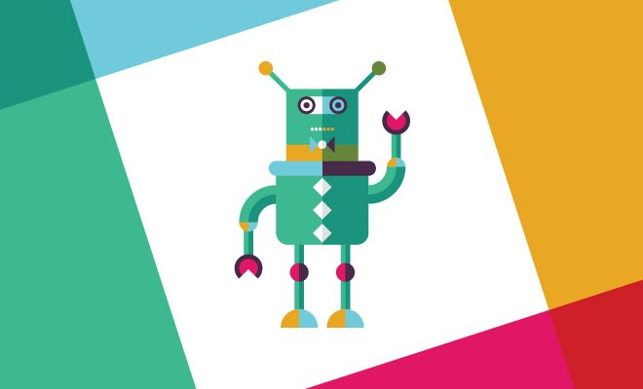
Slack Bot
Interfaces with users where they are.

Slide 35
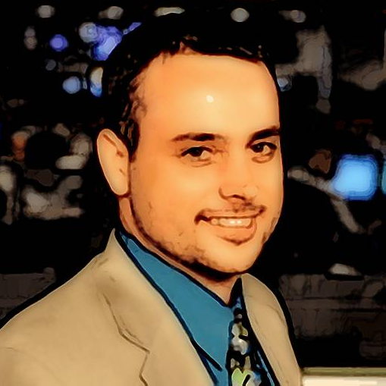
Conversational Bots
Facebook Messenger
@CujoAi
https://www.messenger.com/t/cujoai

Slide 36
Trend: Robots
Real, physical, moving, remote and autonomous objects.

Slide 37
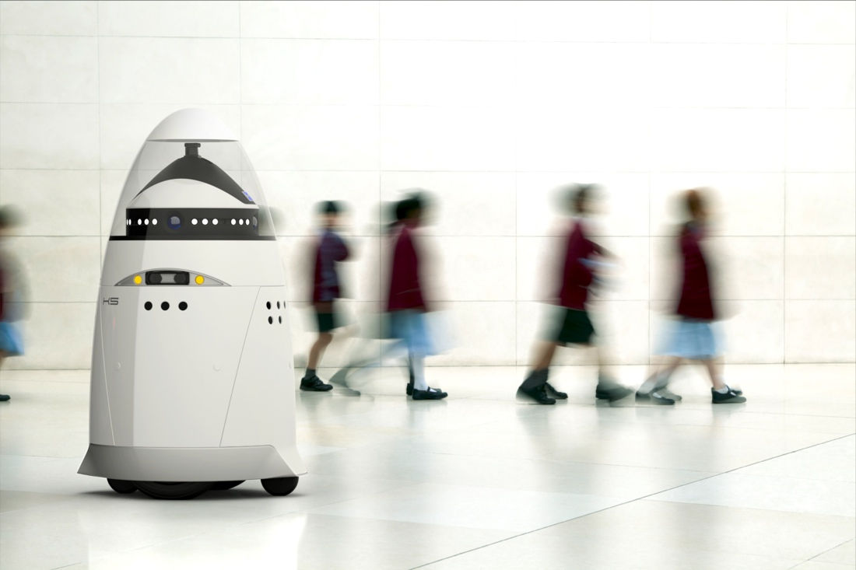
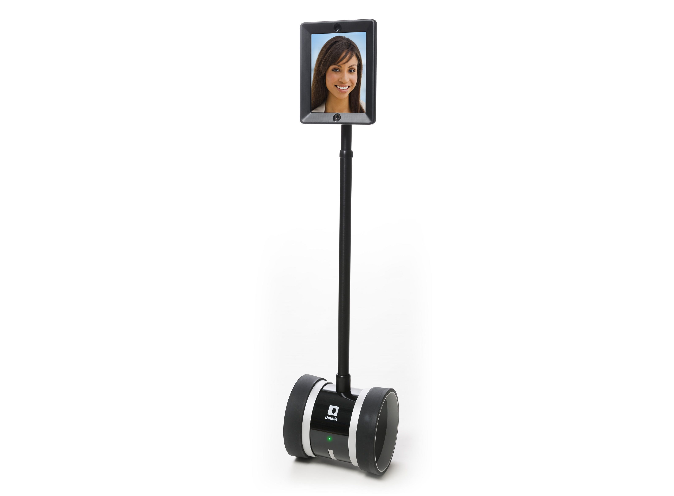

Slide 38
Robots and Drones Will Be:
Task specific
Multiple Sensors
Interconnected

Slide 39
Trend: Algorithmic Personality Value
All that data out there…

Slide 40
What if…
A student wants to pitch me on an idea and they want to know the best way to get in touch with me.
They might ask someone that knows me, “How would you approach Professor King about my start up idea?”
Or…

Slide 41
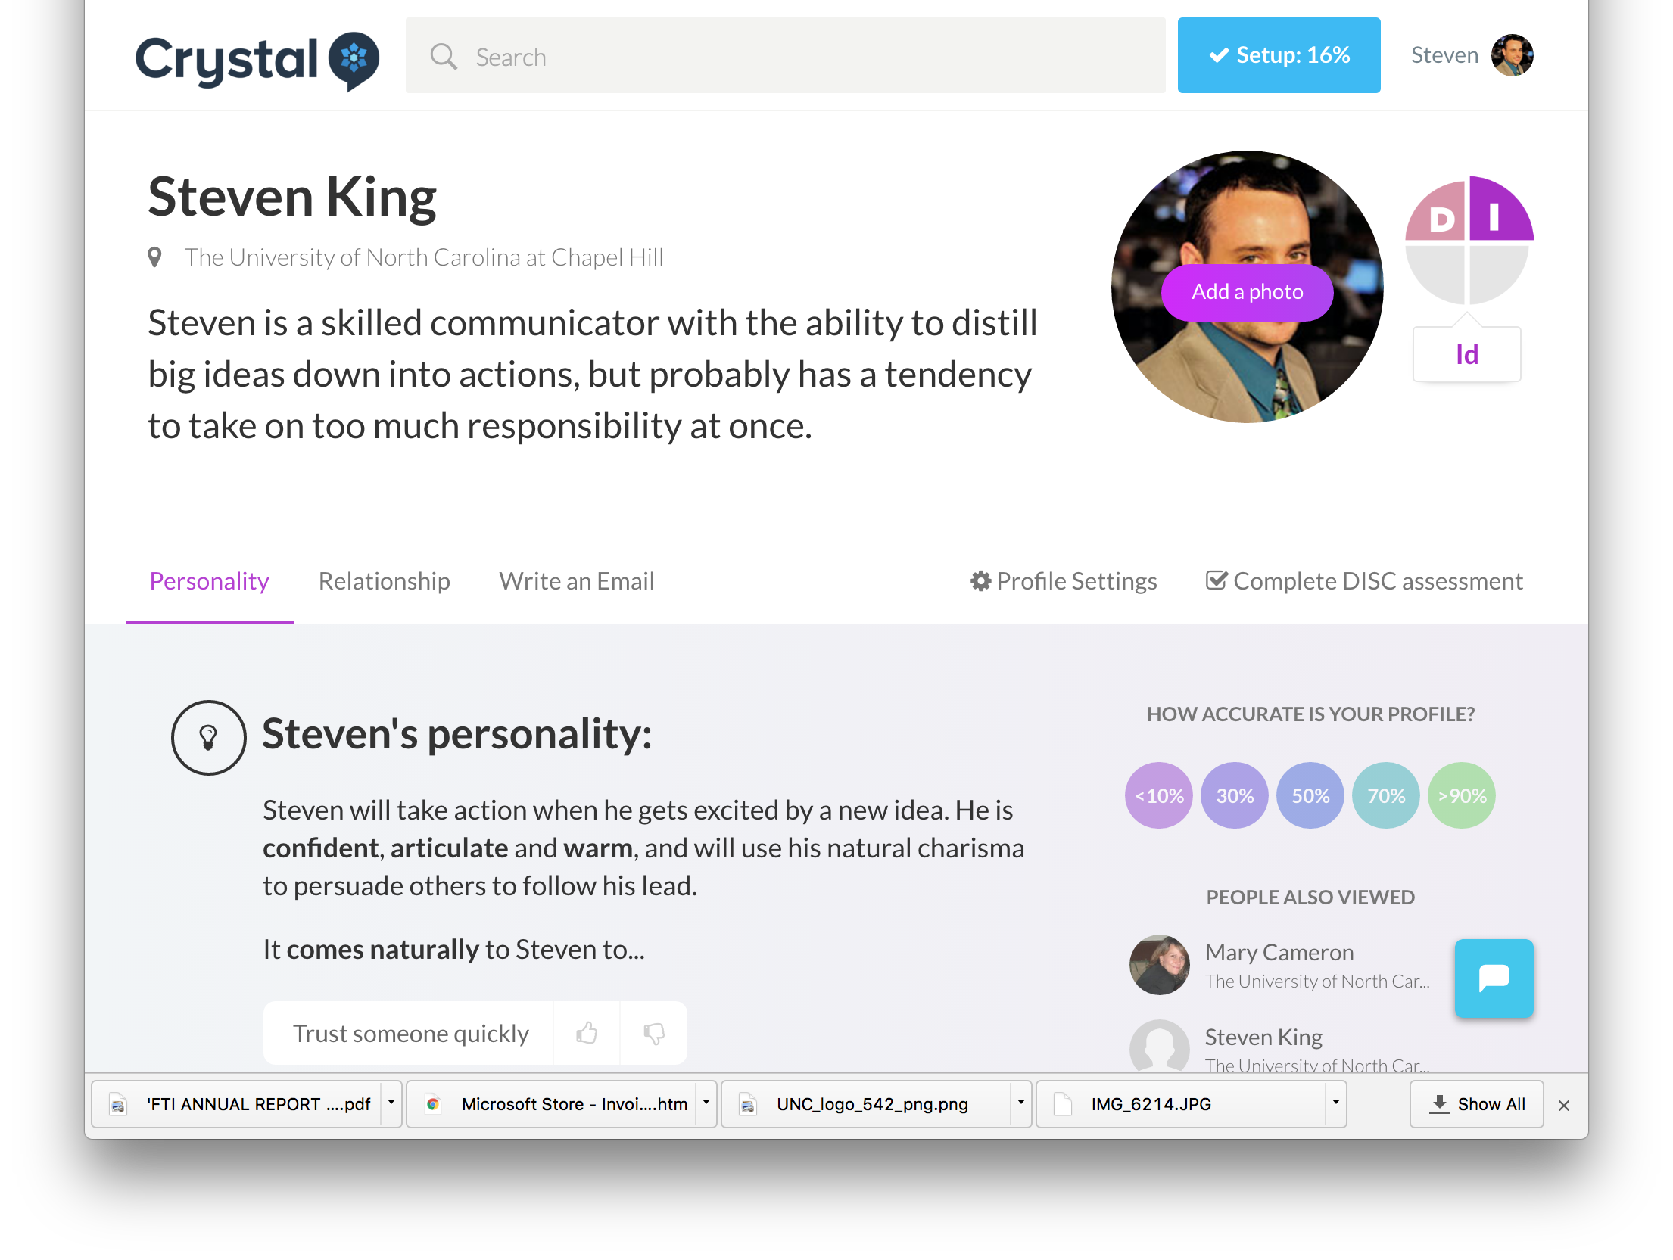
Algorithmic Personality Test

Slide 42
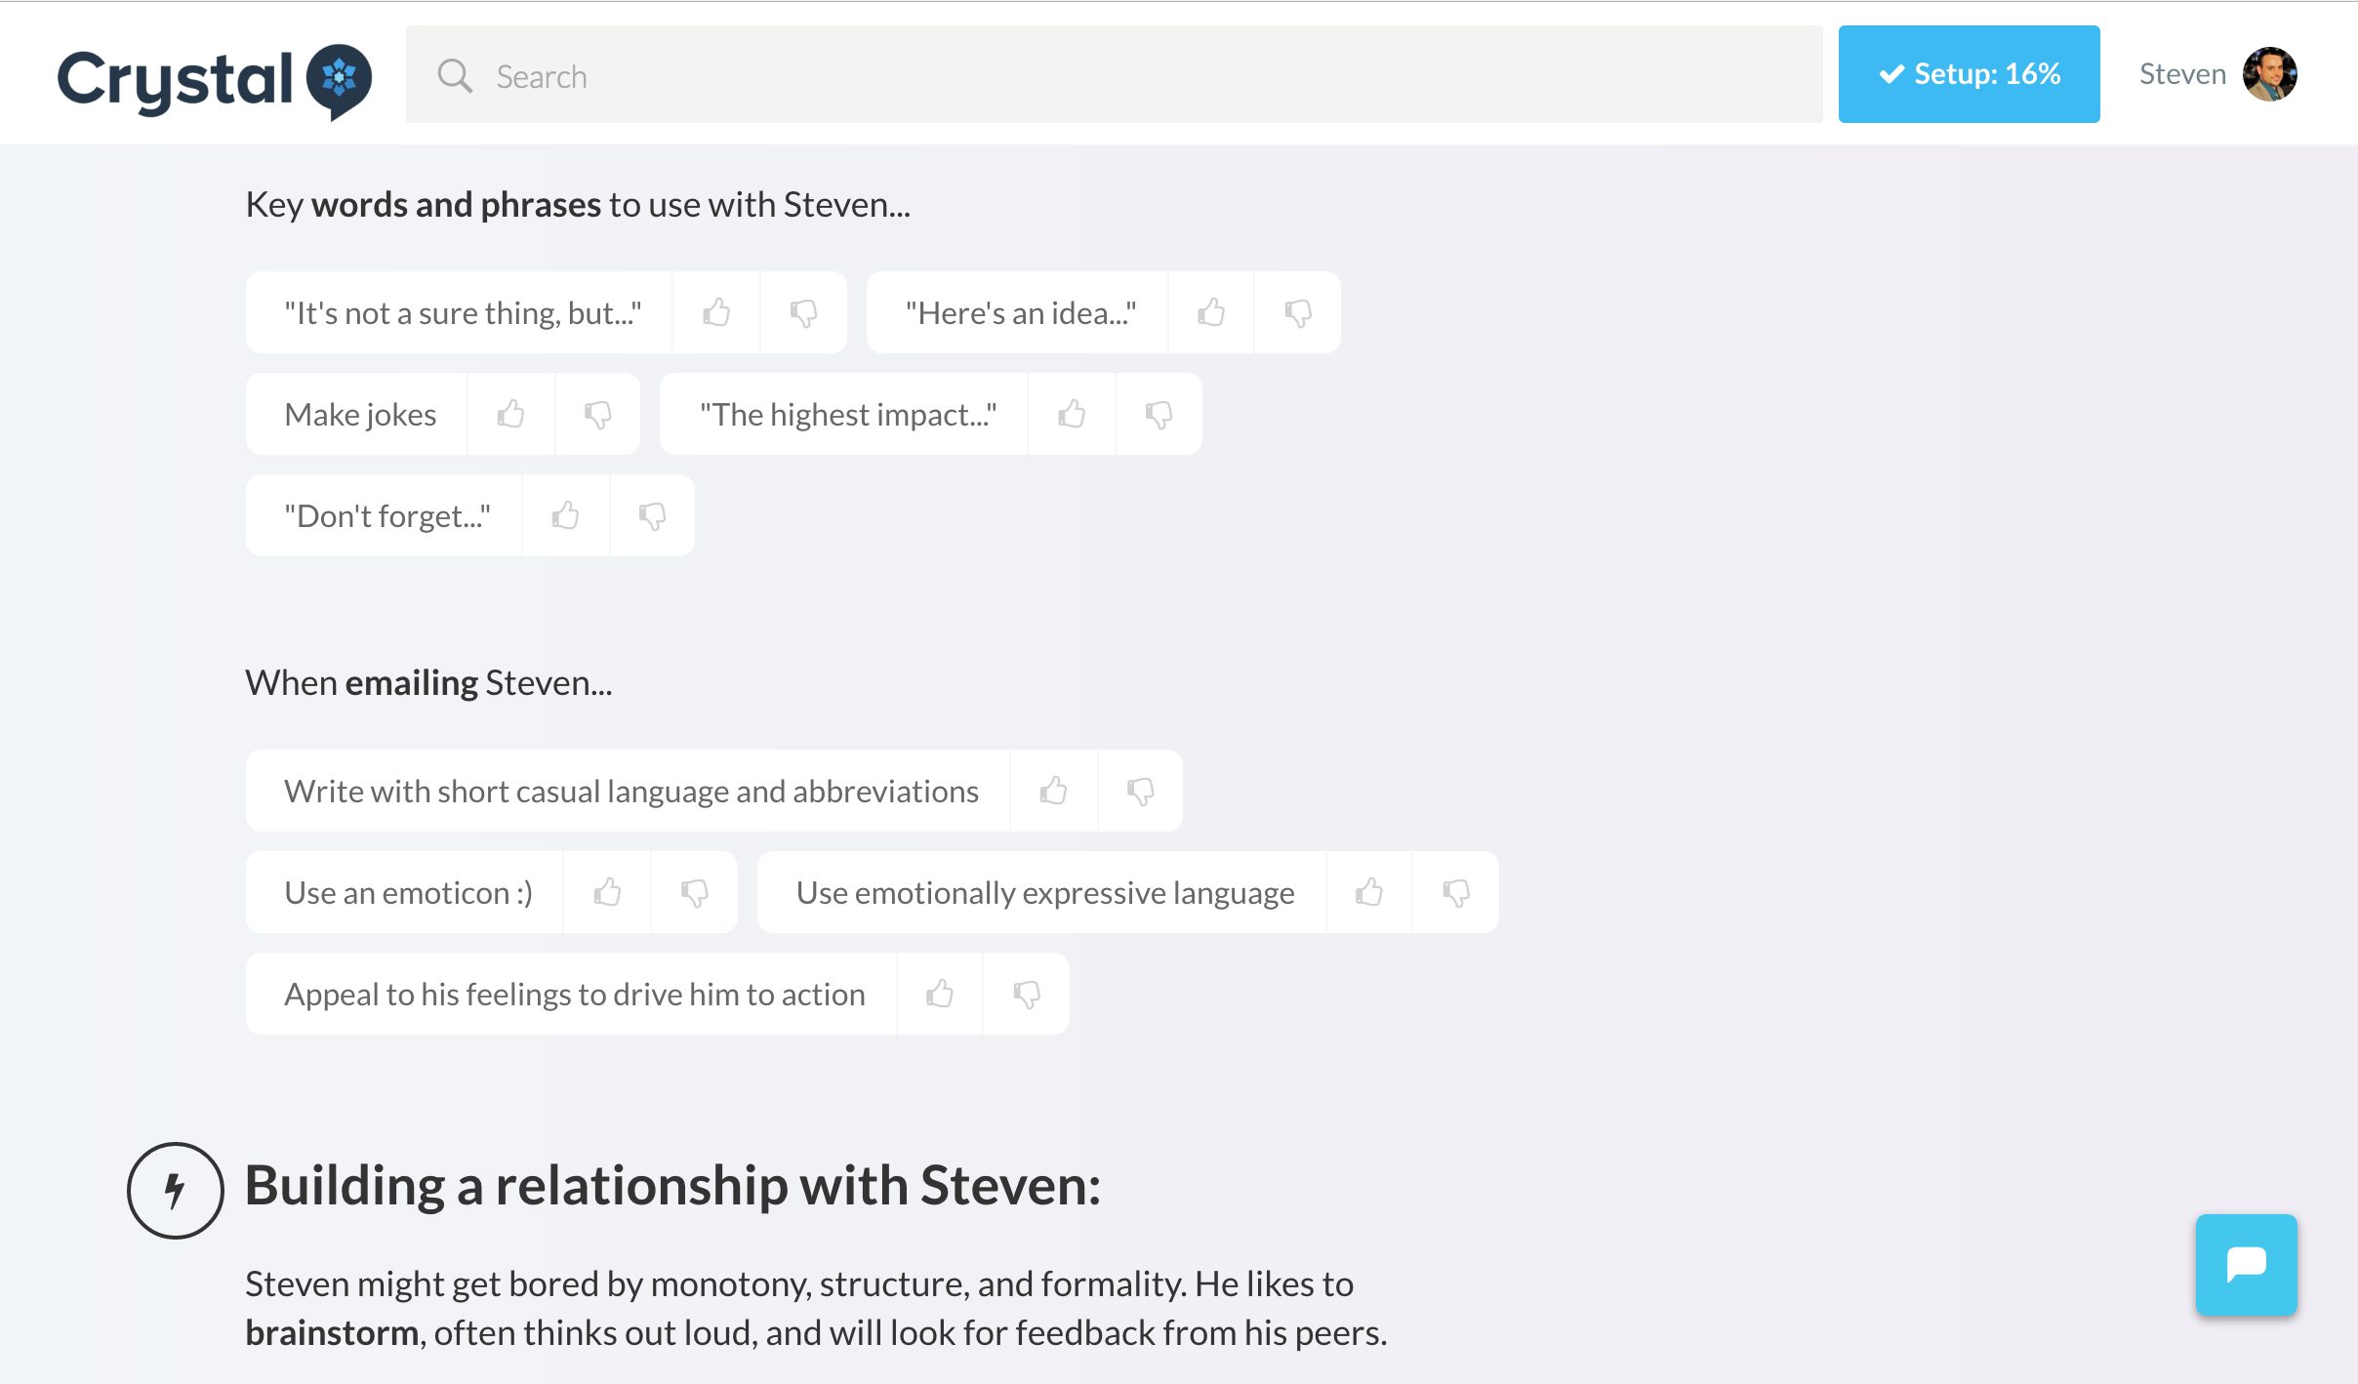
Algorithmic Personality Test

Slide 43
Trend: Intelligent Visual Surveillance
Image Entity Detection with Big Data

Slide 44
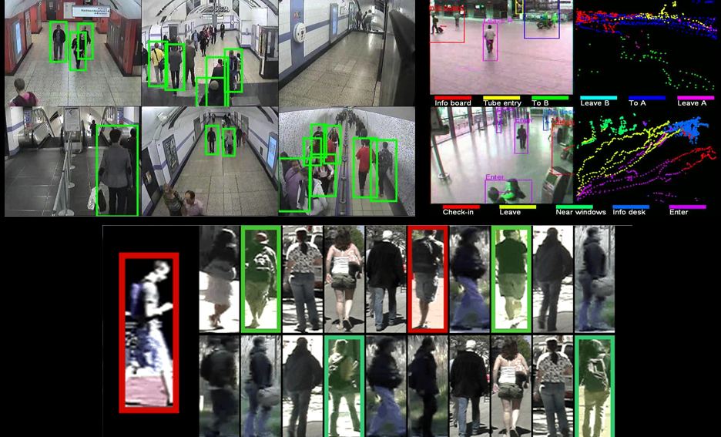

Slide 45
Trend: Security and Privacy Policy Shift
All that data out there…

Slide 46
Security Concerns
Zero Day Exploits Rising
System-wide glitches due to interconnected dependence
ex. Delta, NY Stock Exchange
Increase off-book Back-doors
Long-time developers leaving intentional back-doors for later exploit.
Backdoor bounty
Internet of Things hacks

Slide 47
Privacy Policy
Continued requests for “Golden Keys”
Self Incrimination Data and More Requests
Choice of Anonymity
Trend towards Sterilization of Data
Synthetic Data Sets
Internet of Things hacks

Slide 48
Trend: Torrents and Darknets
Move from Cloud to Crowd

Slide 49
Torrents and Darknets for Legal, but private activity
On student and personal fonts a move from cloud to crowd storage.

Slide 50
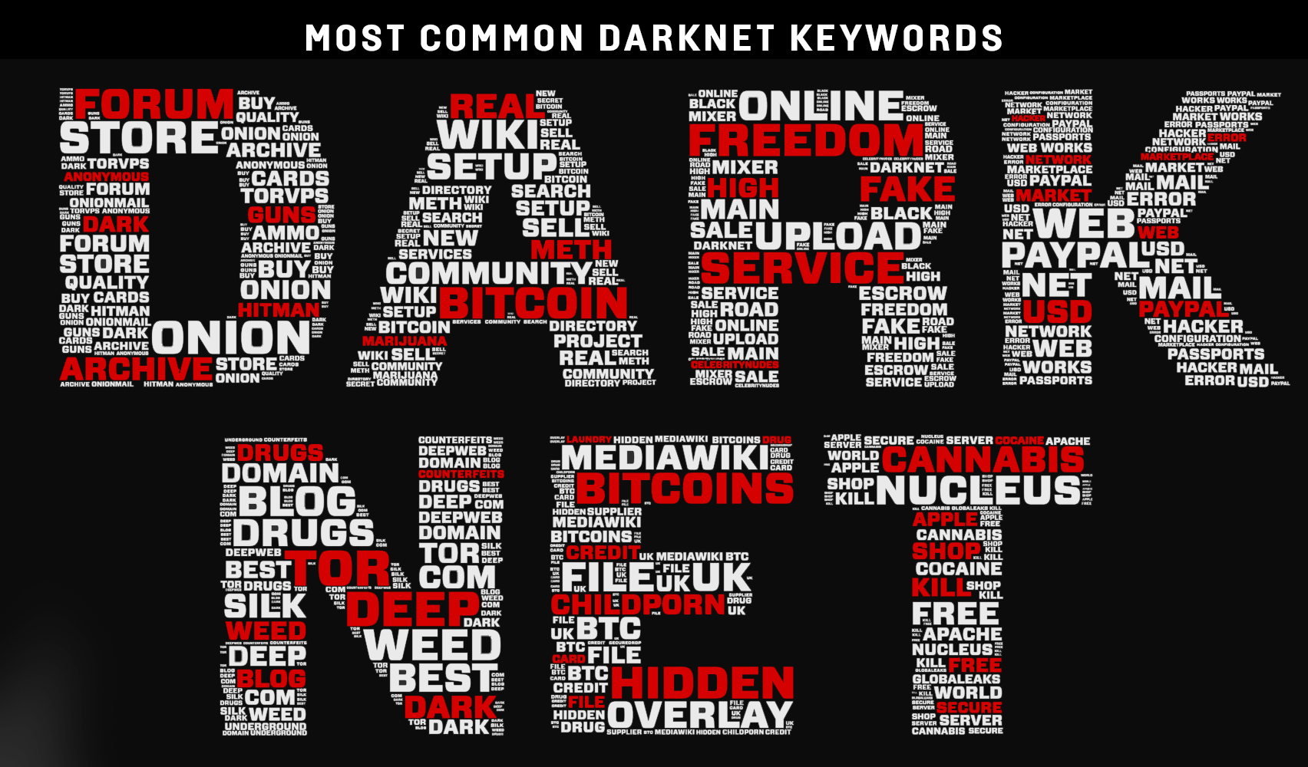

Slide 51
Trend: VR to AR and back
Virtual Reality, Augmented Reality and Reality

Slide 52
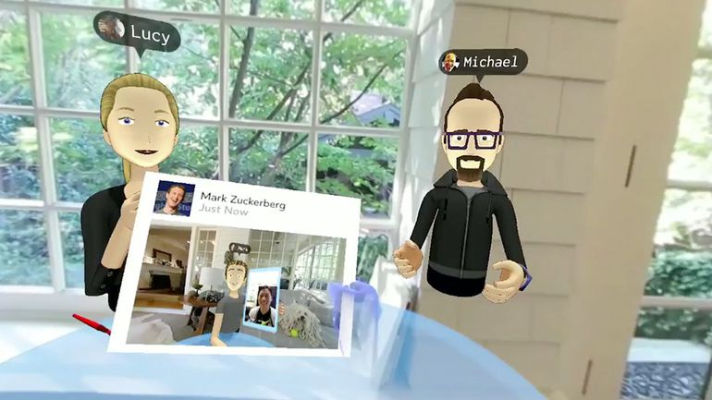

Slide 53
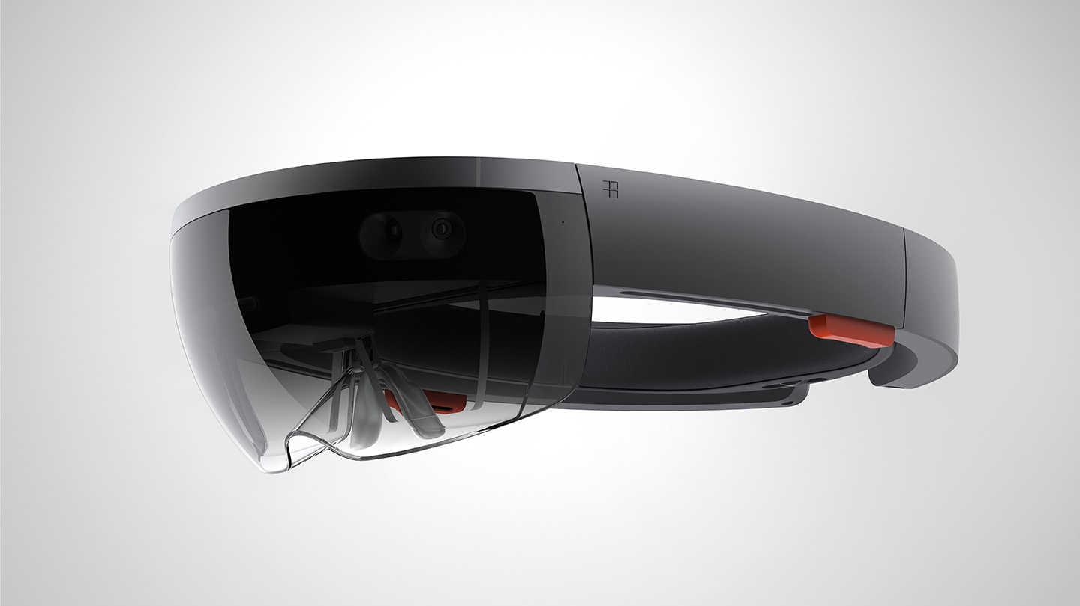

Slide 54
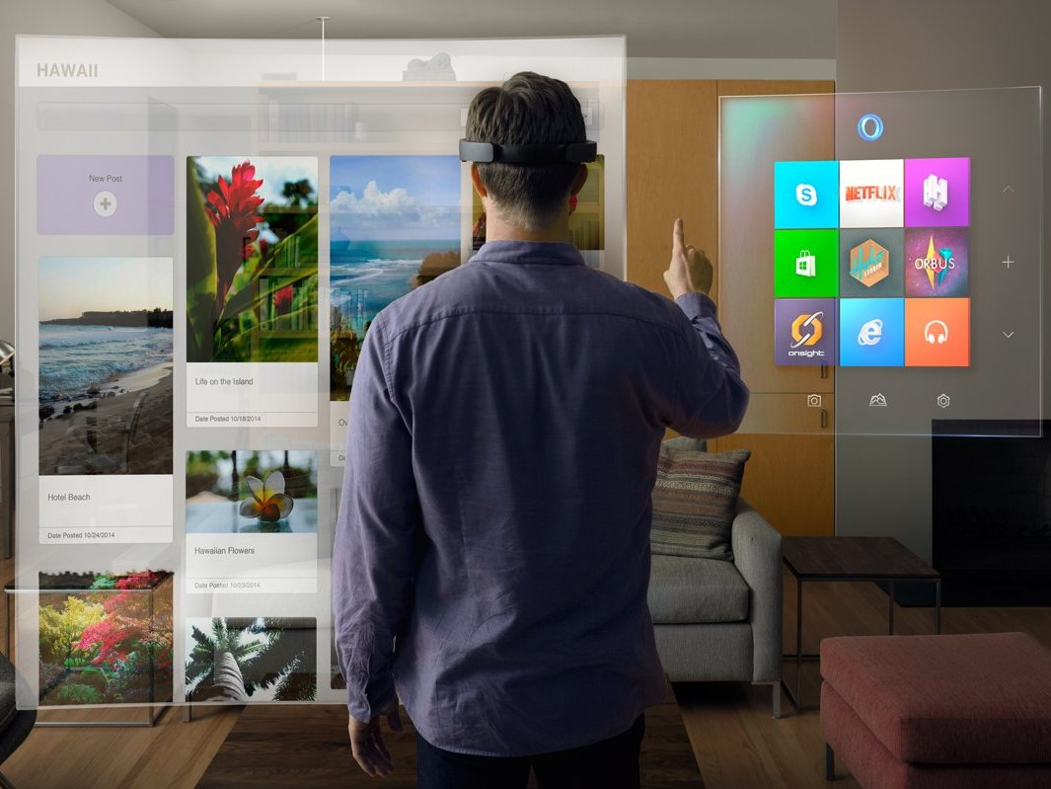

Slide 55
Notes:
People have dreamed of electric cars, self-driving cars and even flying cars. We dream of diets with no calories, wars with no death and life without pain.

Slide 56

Steven King
@CujoAi (chat bot)
@steven_king
steven.king@unc.edu

